Slide 1
Unified sensor platform
I2C(Inter-Integrated Circuit) and SPI (Serial Peripheral Interface)

Slide 2
Introduction to I2C (Inter-Integrated Circuit)
I²C (Inter-Integrated Circuit, alternatively known as I2C or IIC, is a synchronous, multi-controller/multi-target (controller/target), packet switched, single-ended, serial communication bus invented in 1982 by Philips Semiconductors.
It is widely used for attaching lower-speed peripheral ICs to processors and microcontrollers in short-distance, intra-board communication.

Slide 3
Working of I2C
It uses only 2 bi-directional open-drain lines for data communication called SDA and SCL. Both these lines are pulled high.
Serial Data (SDA) – Transfer of data takes place through this pin. Serial Clock (SCL) – It carries the clock signal.
I2C operates in 2 modes –
Master mode
Slave mode

Slide 4
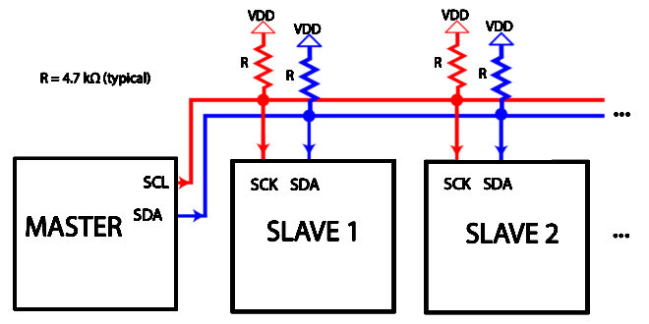

Slide 5
Data protocol of I2C
The data is transmitted in the form of packets which comprises 9 bits. The sequence of these bits are –
Start Condition – 1 bit
Slave Address – 8 bit
Acknowledge – 1 bit

Slide 6
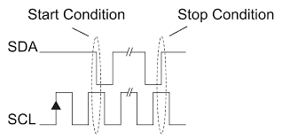
Start and Stop Conditions
START and STOP can be generated by keeping the SCL line high and changing the level of SDA. To generate START condition the SDA is changed from high to low while keeping the SCL high. To generate STOP condition SDA goes from low to high while keeping the SCL high

Slide 7
Read/Write Bit :
A high Read/Write bit indicates that the master is sending the data to the slave, whereas a low Read/Write bit indicates that the master is receiving data from the slave.
ACK/NACK Bit :
After every data frame, follows an ACK/NACK bit. If the data frame is received successfully then ACK bit is sent to the sender by the receiver.
Addressing :
The address frame is the first frame after the start bit. The address of the slave with which the master wants to communicate is sent by the master to every slave connected with it. The slave then compares its own address with this address and sends ACK.

Slide 8
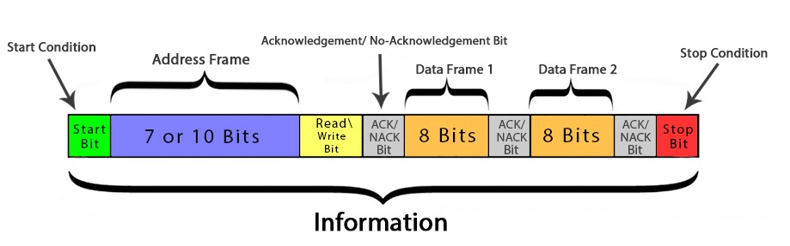

Slide 9
Advantages and limitations
Advantages :
Can be configured in multi-master mode.
Complexity is reduced because it uses only 2 bi-directional lines (unlike SPI Communication).
Cost-efficient.
It uses ACK/NACK feature due to which it has improved error handling capabilities.
Limitations :
Slower speed.
Half-duplex communication is used in the I2C communication protocol.

Slide 10
Introduction to SPI
The Serial Peripheral Interface (SPI) is a synchronous serial communication interface specification used for short-distance communication, primarily in embedded systems. The interface was developed by Motorola in the mid-1980s and has become a de facto standard. Typical applications include Secure Digital cards and liquid crystal displays.

Slide 11
The SPI bus specifies four logic signals:
SCLK: Serial Clock (output from master)
MOSI: Master Out Slave In (data output from master)
MISO: Master In Slave Out (data output from slave)
CS /SS: Chip/Slave Select (often active low, output from master to indicate that data is being sent)
MOSI on a master connects to MOSI on a slave. MISO on a master connects to MISO on a slave. Slave Select has the same functionality as chip select and is used instead of an addressing concept.

Slide 12
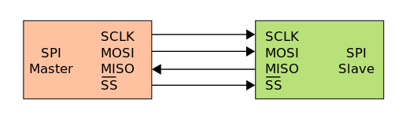
Single master to single slave: basic SPI bus example

Slide 13
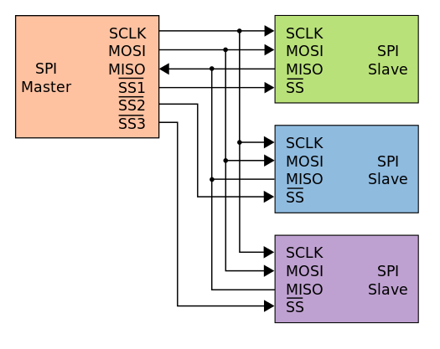
Typical SPI bus: master and three independent slaves

Slide 14
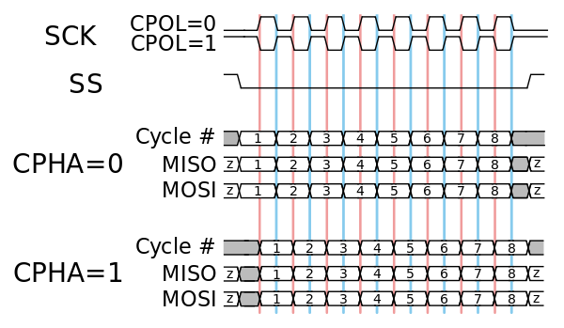
Clock Polarity and Phase

Slide 15
Thank you

